Slide 1
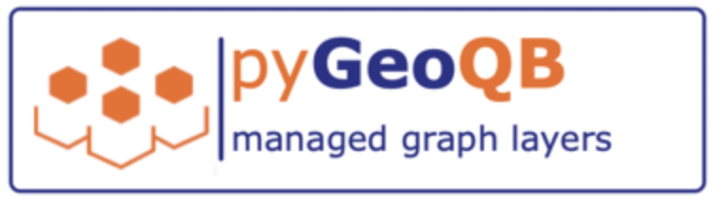
Working with a graph data model to study and manage sustainability data.

Slide 2
JUDGING CRITERIA - Hackathon
Impactfulness: Using better valid and relevant information is an advantage over decision making with limited information or low quality information. Democratization of skills and tools requires also access to relevant information. In order to overcome the limitations of today‘s data management principles we want to contribute to a new graph based approach for modeling the intent and the purpose of data in such a way, that context sensitive data flows can be automated based on expected outcome.
Innovativeness Besides the concept of publicly managed graph data assets we also contribute to a global data asset inventory which allows all of us to learn what data is used for which purpose. Furthermore we can start to track data coverage and improve data availability together with data quality.
Ambitiousness Our goal is to cover the full OpenStreetmap data and all Wikipedia data in one place. In addition, regional data assets will be blended in. This is a scale which currently can only be handled by the biggest software companies. But our global reseach community must be able to use such information for future research which includes contextual analysis and analysis of humen decision making and behavioural analysis in real world szenarios.
Applicability The demo we provide is a working example of the concept. Using a unified graph data model and a graph based metadata model is both possible in any industry given current infrastructure and available cloud servicces.

Slide 3
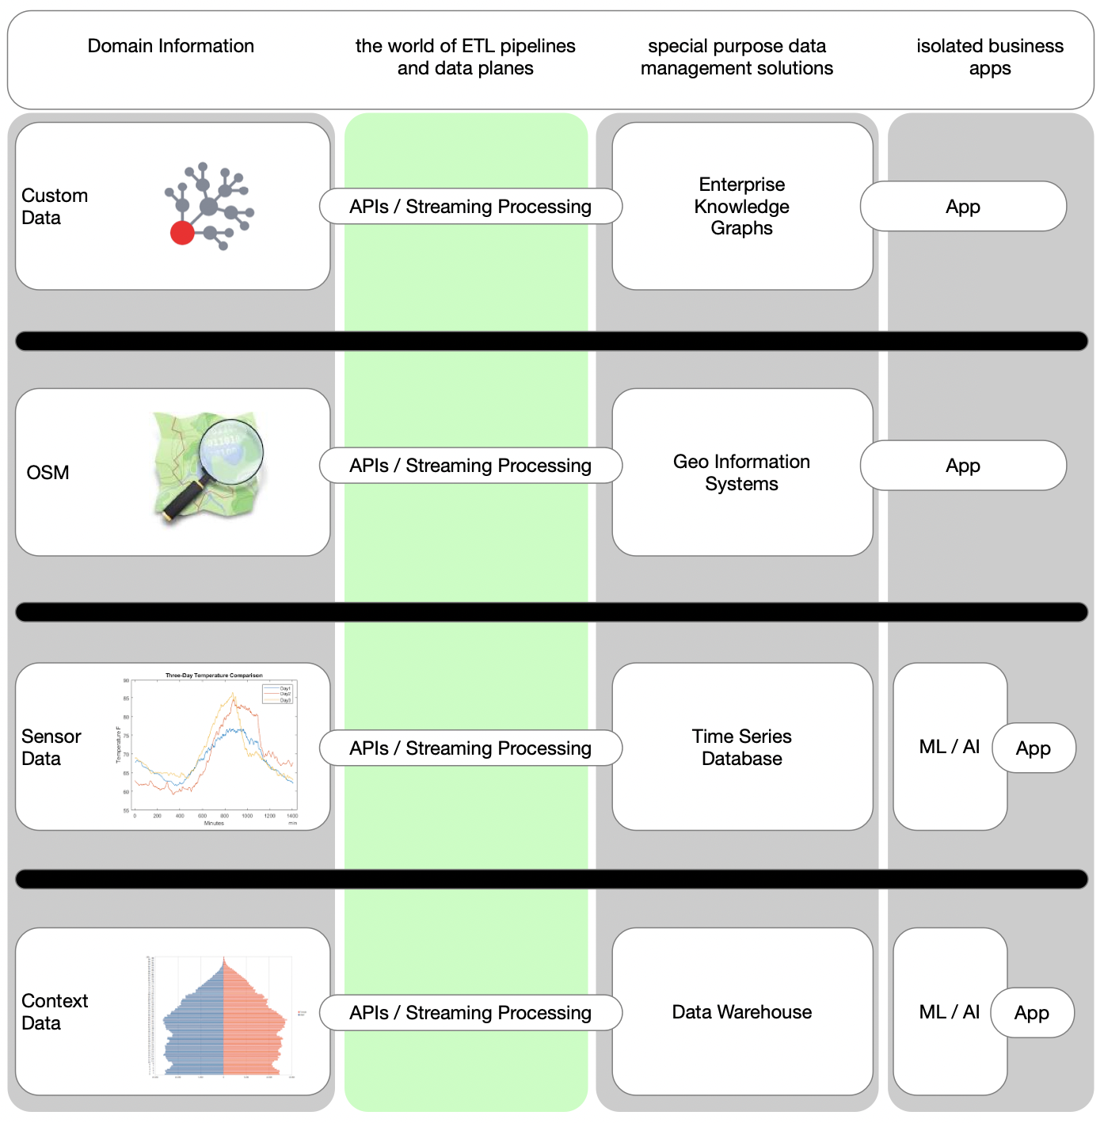
The Problem: Isolation of data assets
Notes:
Many public data assets are isolated
Integration of such public data is not easy, even with todays modern data platforms and cloud bases solutions.
One important goal is to overcome the barriers between the application domains.

Slide 4
Our Goals …
Simplify data integration & data blending using a multi-layer graph model.
1
Use TigerGraph as central platform for data management, data integration, and scalable analysis.
2
Establish a standard for contextual data blending.
This allows integration of multiple domains as multi-layer graphs.
3

Slide 5
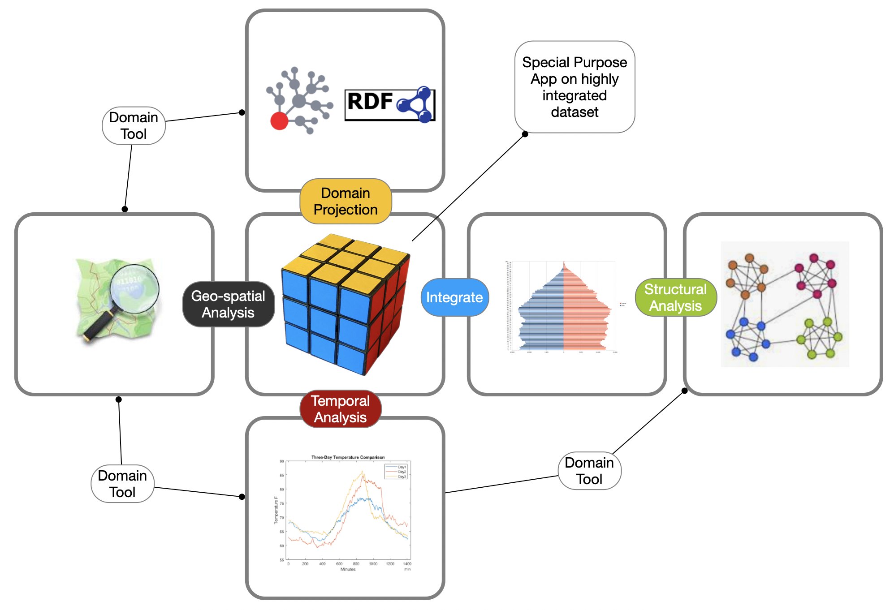

Our Solution:
multi-layer graphs with easy projection and transformations
Today:
isolated lanes …

Slide 6
GeoQB Layers
Data layers are defined by queries and semantic data mappings.

Slide 7
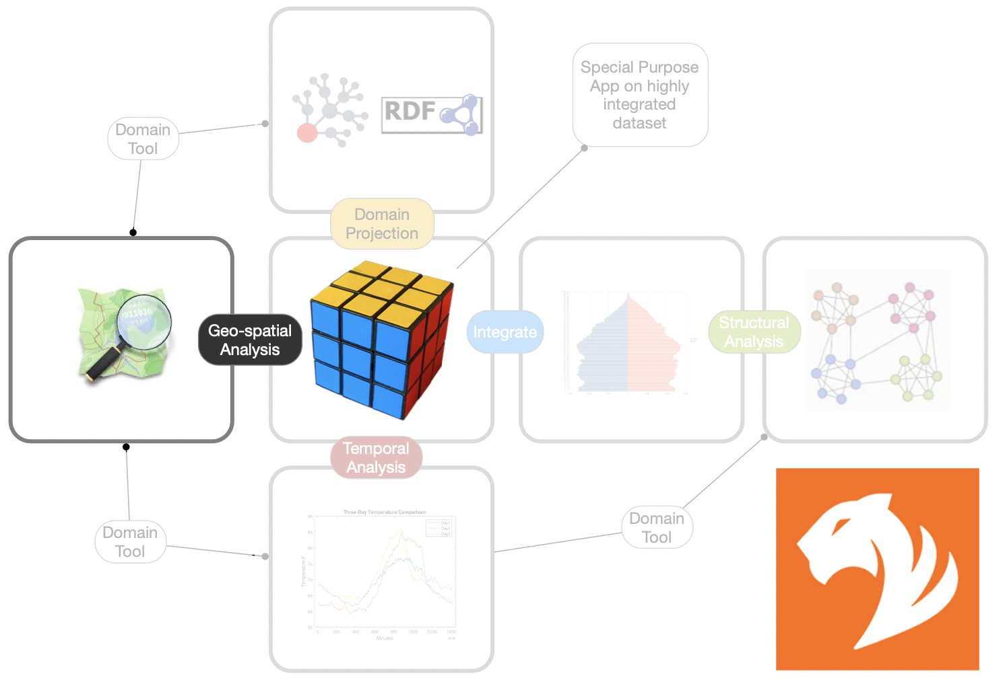

Slide 8
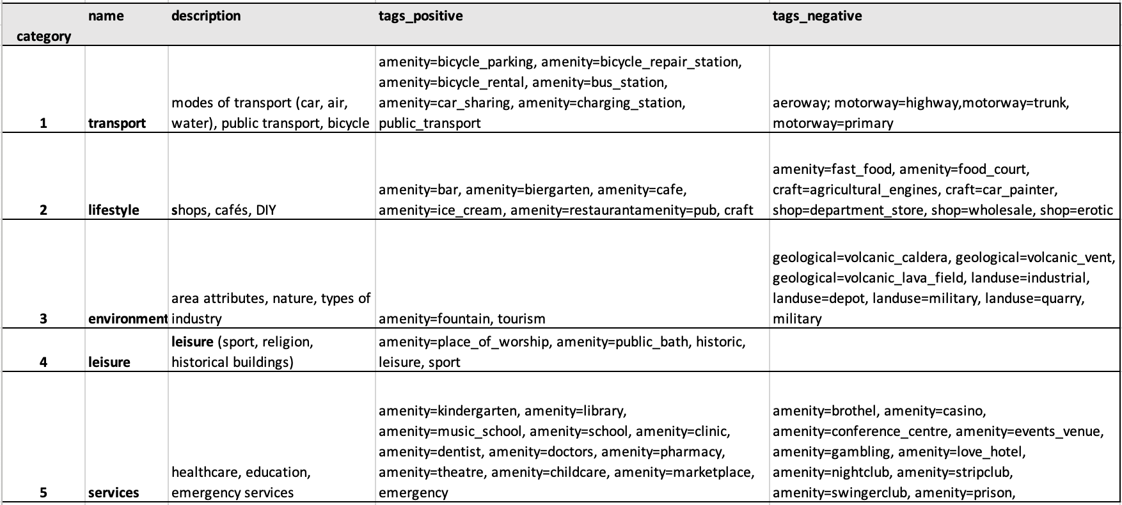
Scene 3, 4, 5
Creation of a new layer from OSM Domain …

Slide 9
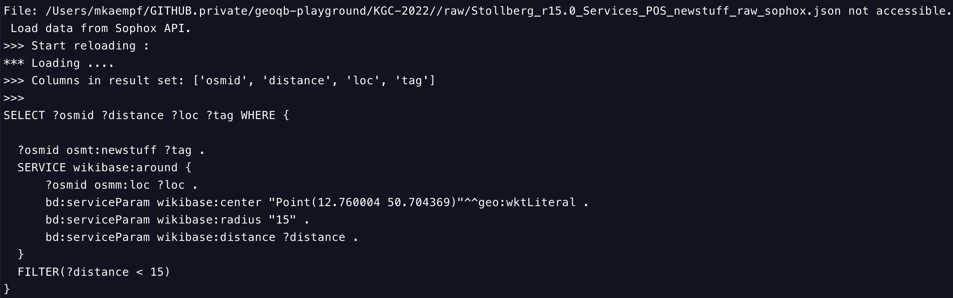
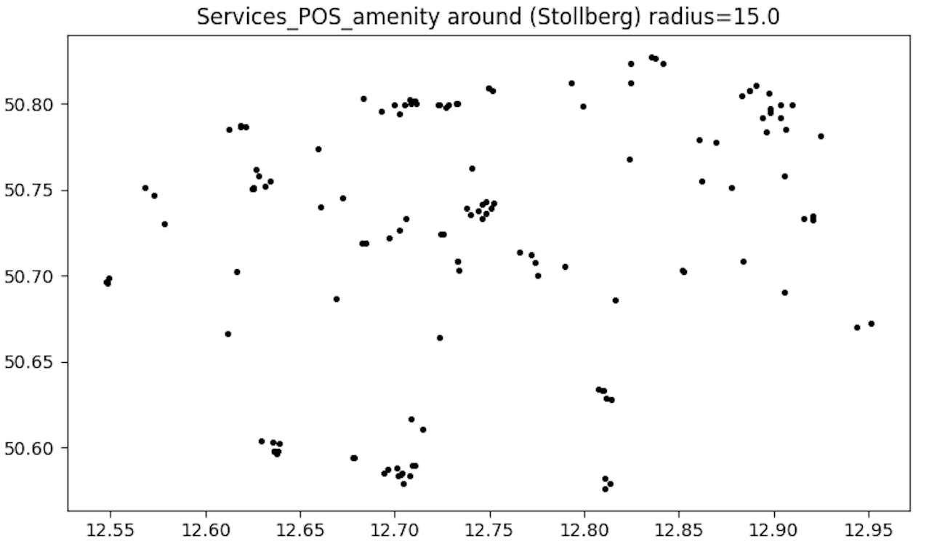
GeoQB Layer
Defined by a SPARQL query.
Buffered in local workspace ➔ ingested into graph data model.

Slide 10
GeoQB Workspace

Slide 11
Using the CLI

Slide 12
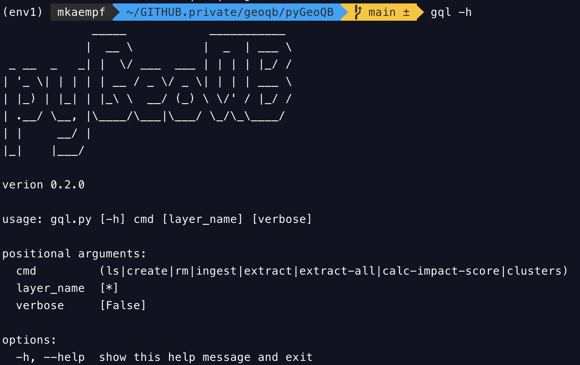

Slide 13
gql create Stollberg
We create the 10 context layers around a selected town.

Slide 14
gql create Stralsund
We create the 10 context layers around a selected town.

Slide 15
gql ingest Stralsund
We load all 10 context layers into the TigerGraph platform.

Slide 16
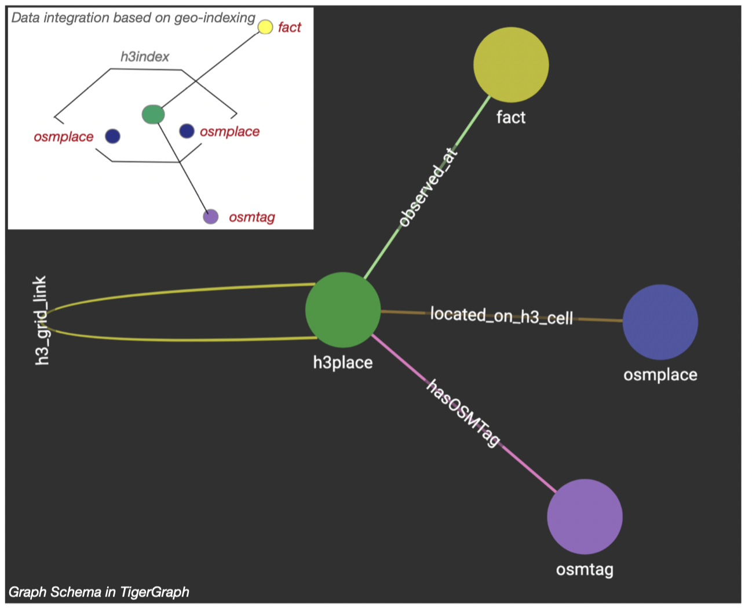

Slide 17
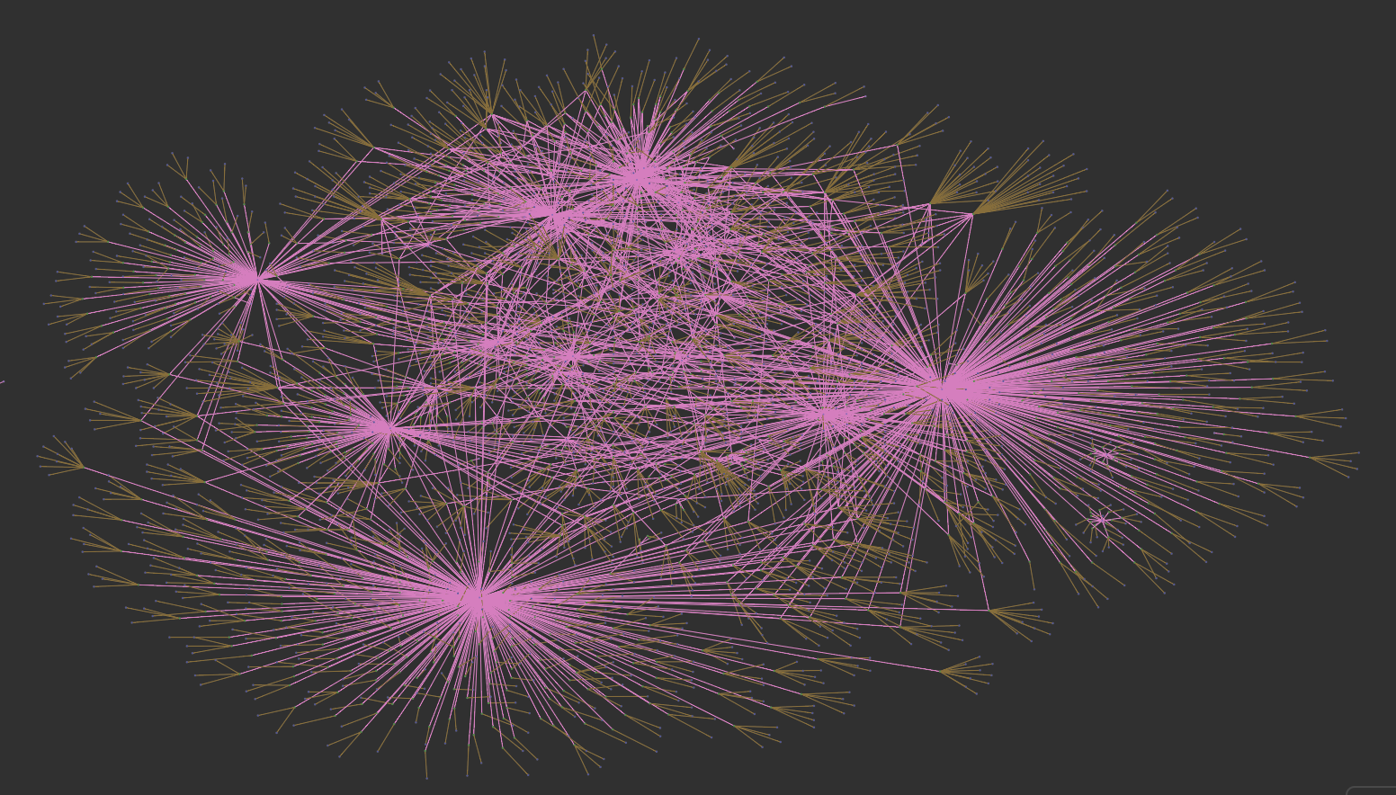
All layers … the backbone of the data model

Slide 18
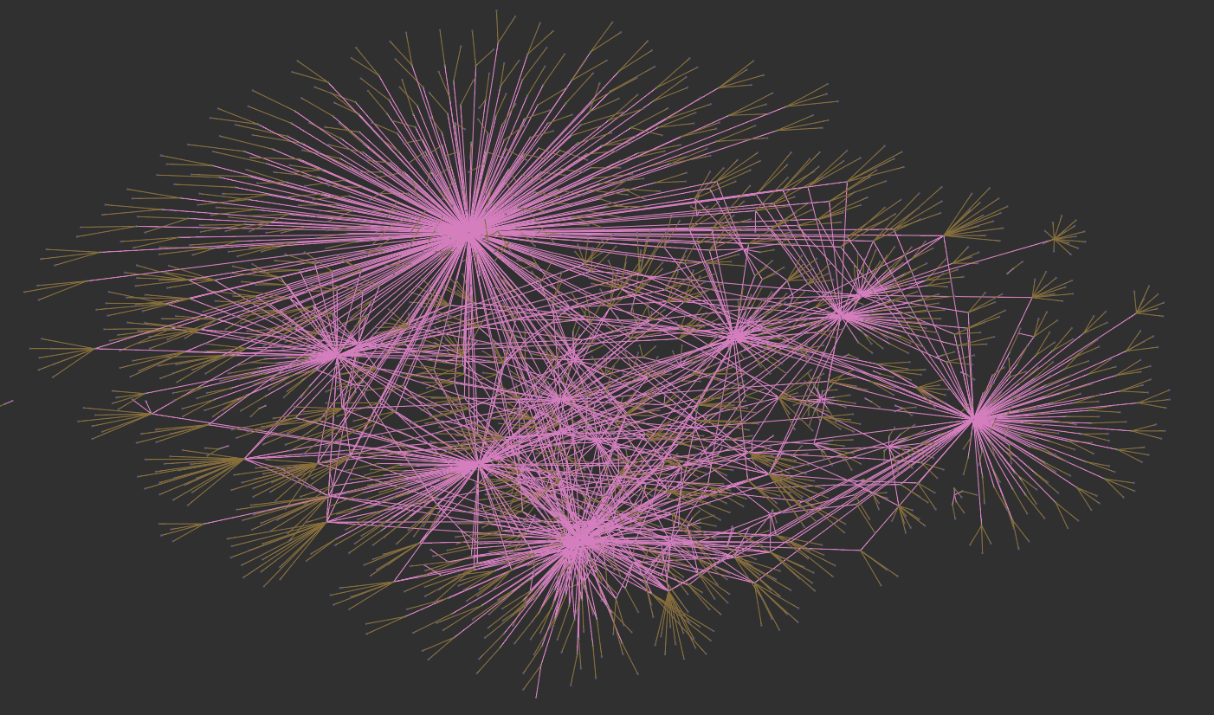
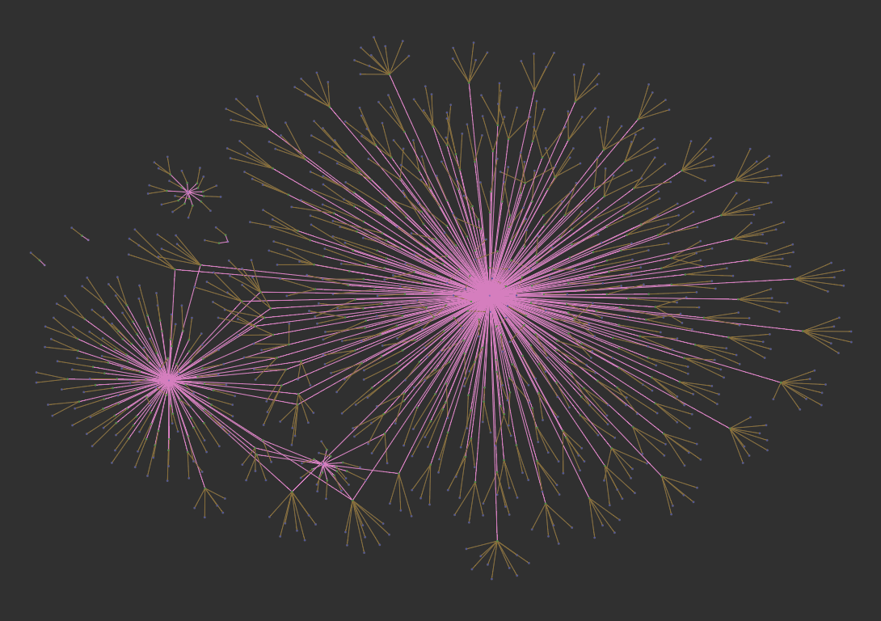
Positive ➔
⬅ Negative

Slide 19
Layer Analysis
Node2Vec based clustering

Slide 20
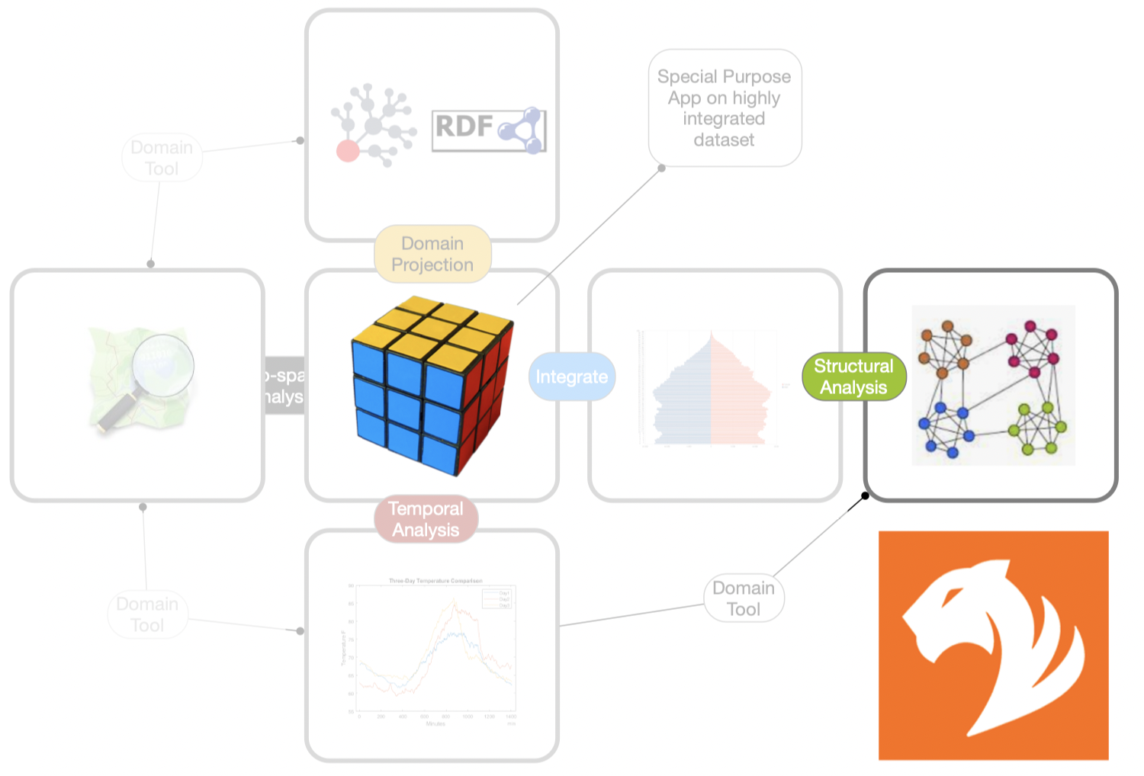

Slide 21
gql extract Stralsund
We load all 10 context layers into the workspace for local analysis.

Slide 22
gql clusters
We load all 10 context layers into the workspace for local analysis.

Slide 23
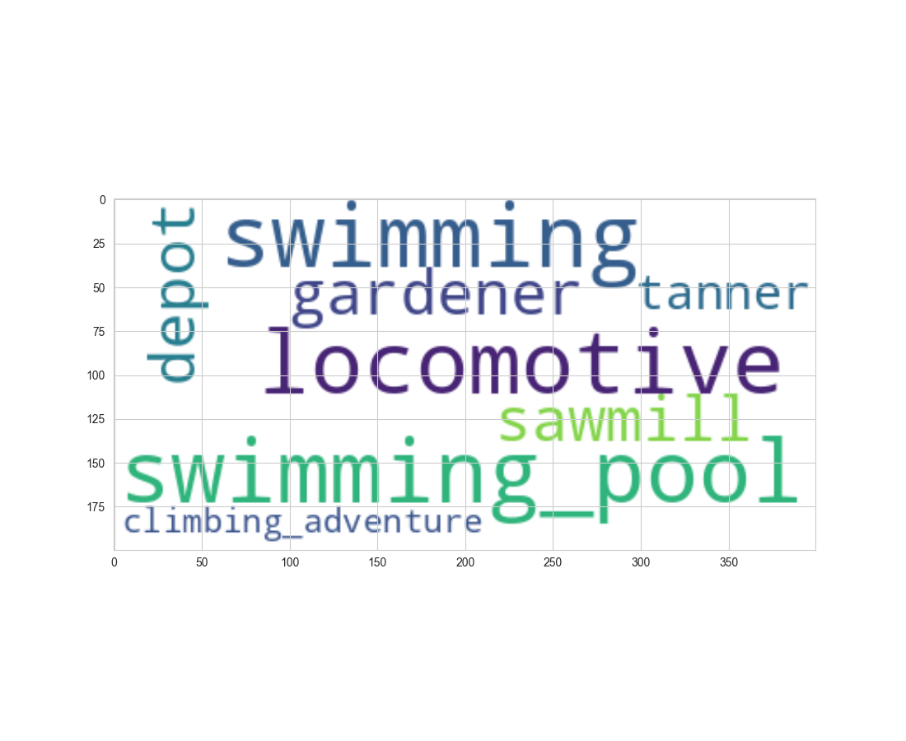
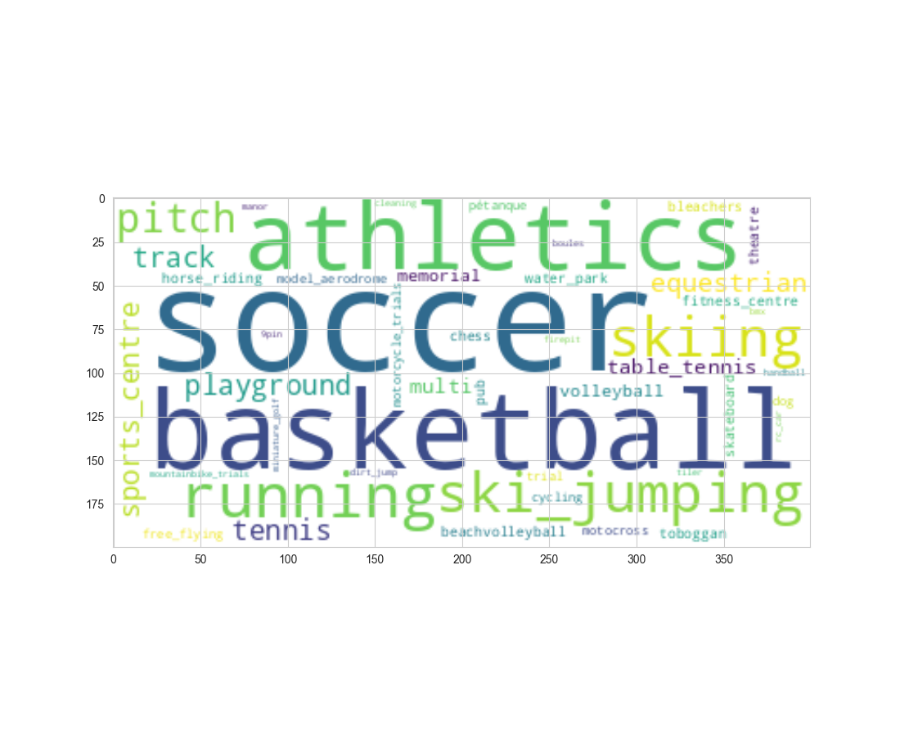
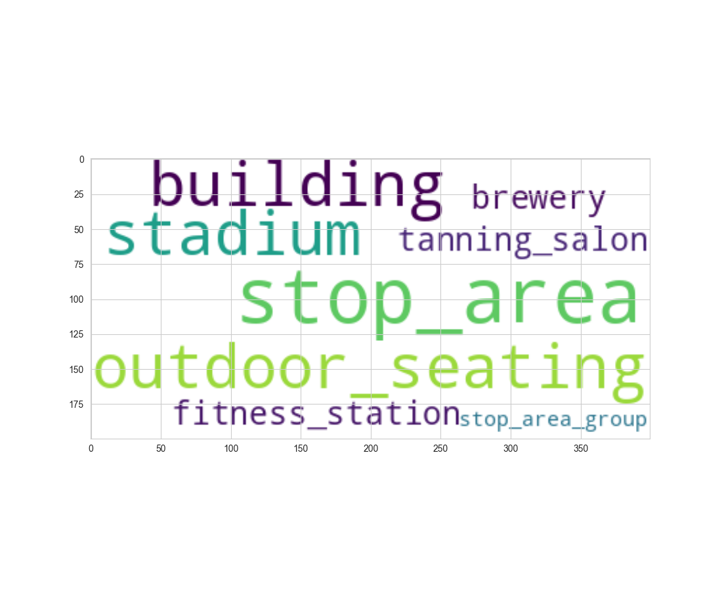
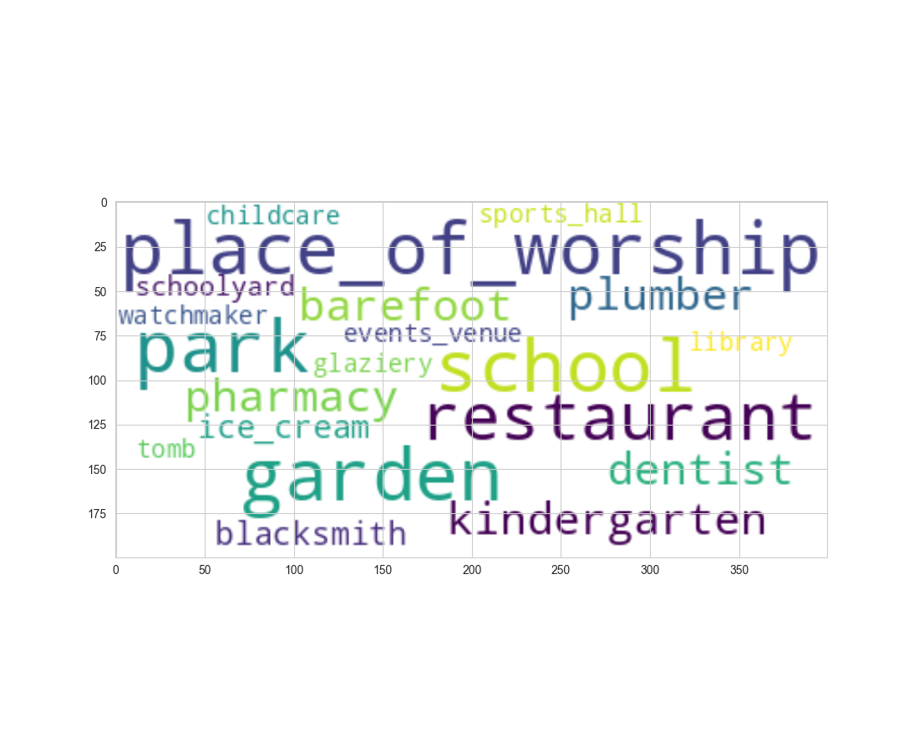
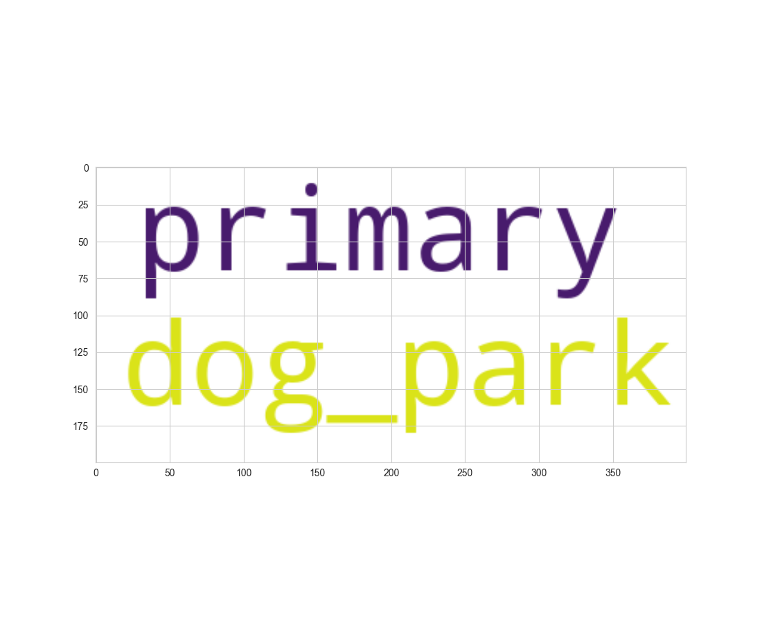
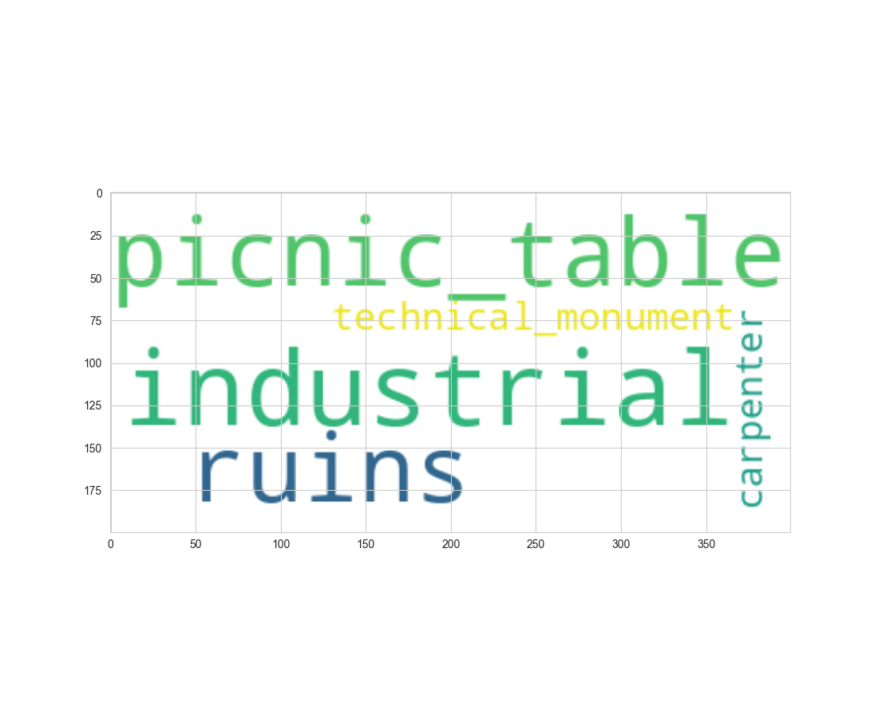
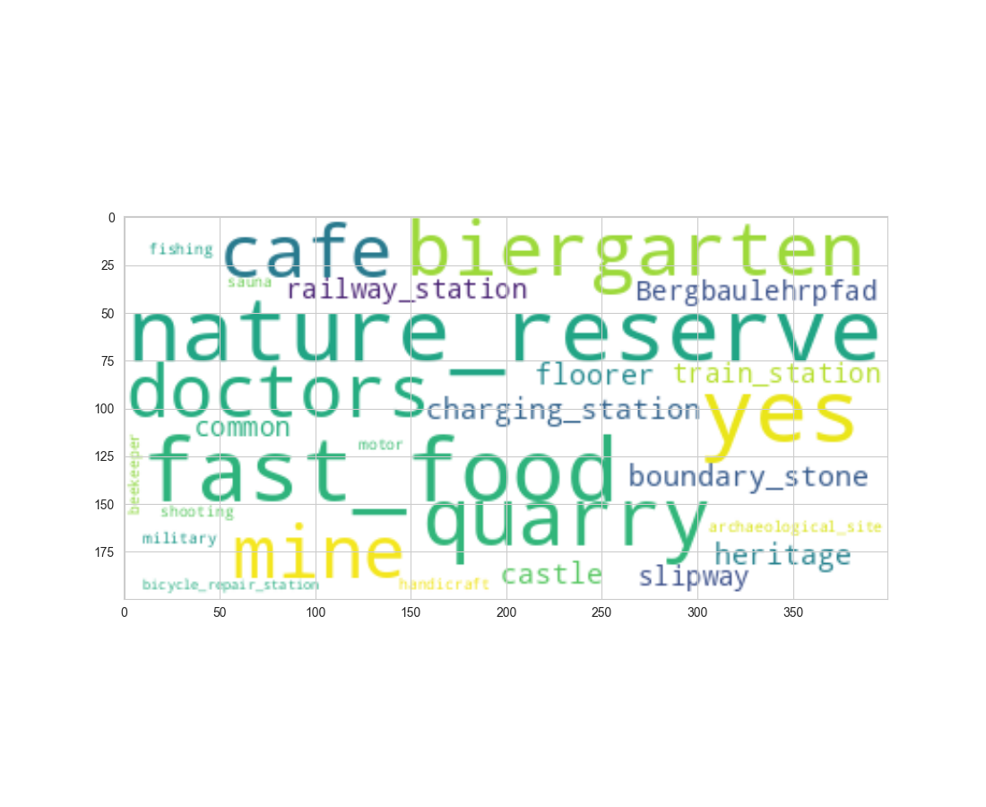
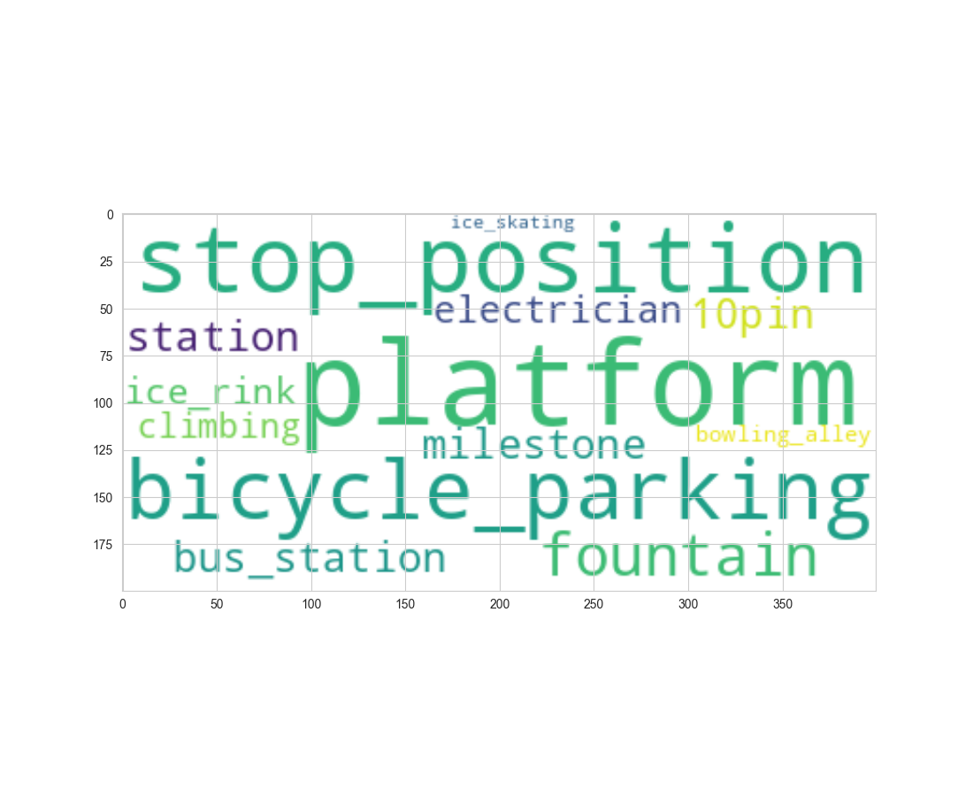

Slide 24
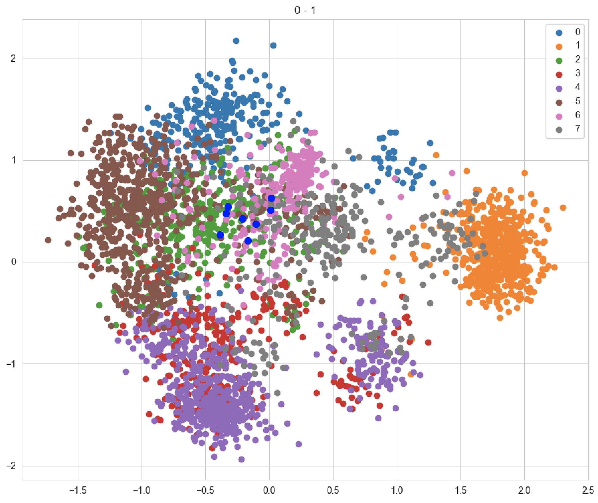

Slide 25
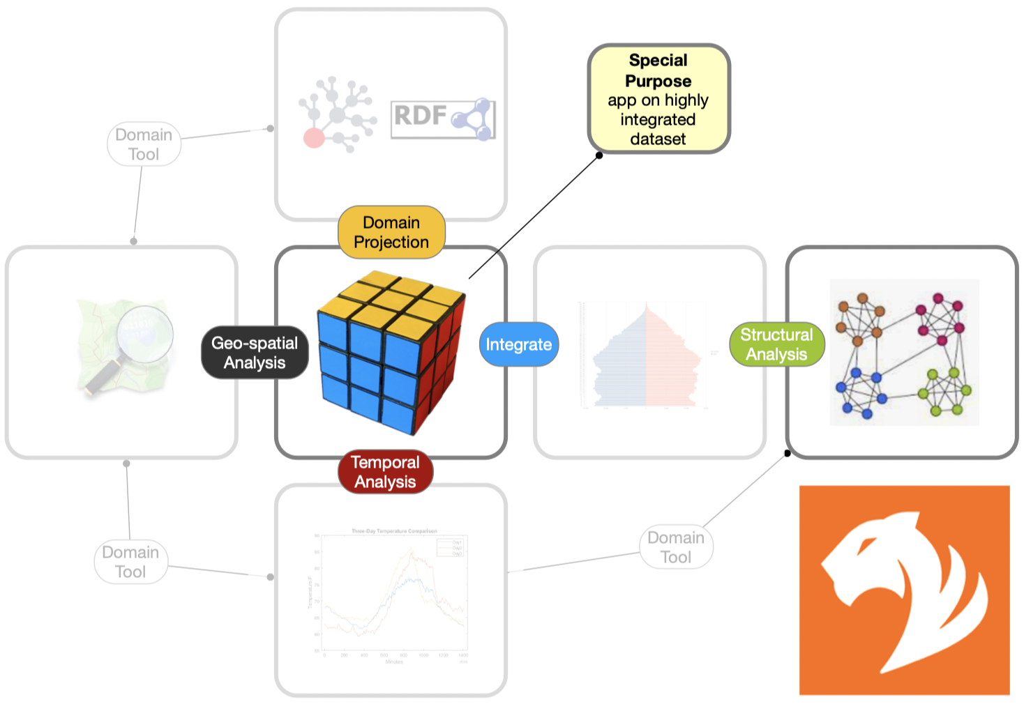
Impact Score

Slide 26
gql calc-impact-score

Slide 27
GeoQB Assets & Data Blending

Slide 28
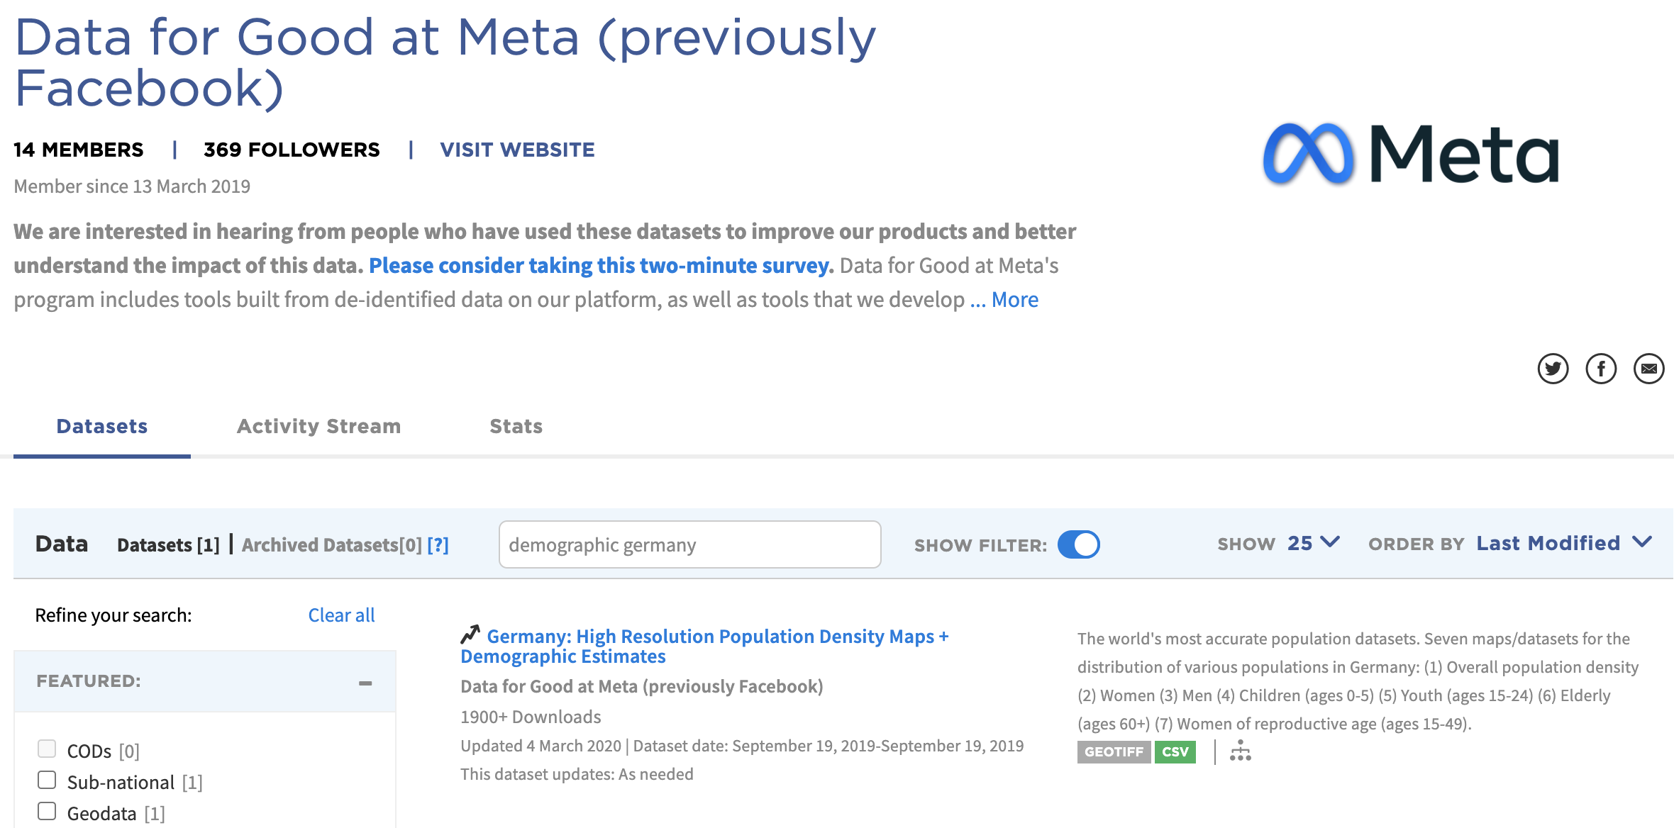

Slide 29
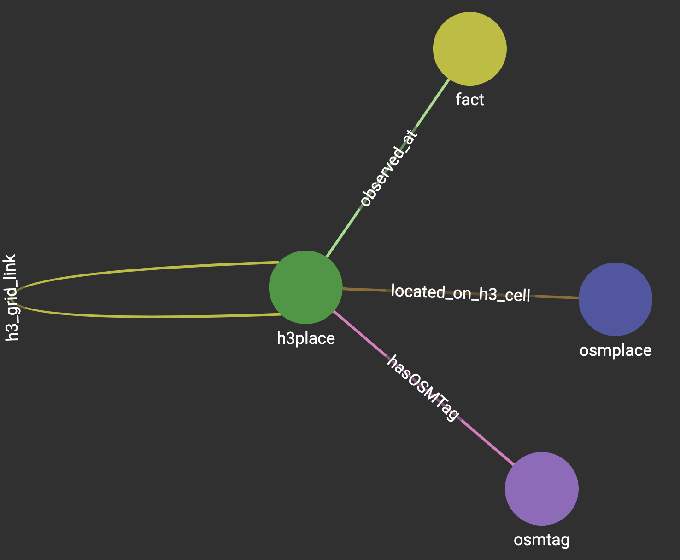
Data Blending …
Observations are added as links bet-ween the place of the observation and an observation-type node. Time and values are modeled as edge properties.

